Slide 1

6th Grade Accelerated Math
Unit 9, Lesson 6 Describing and Interpreting Histograms – Part 2 Volume 2, pg. 69

Slide 2


Benchmarks
MA.6.DP.1.4
Given a histogram or line plot within a real world context, qualitatively describe and interpret the spread and distribution of the data, including any symmetry, skewness, gaps, clusters, outliers, and the range.
volume 2, pg. 69

Slide 3
Integrated Mathematical Thinking and Reasoning Standards
MA.K12.MTR.5.1 Use patterns and structure to help understand and connect mathematical concepts.
MA.K12.MTR.7.1 Apply mathematics to real-world contexts.
volume 2, pg. 69

Slide 4

Learning Targets
I can describe the shape of a histogram.
I can describe the spread of a data set given a histogram.
I can describe gaps, outliers, and clusters in a histogram.
volume 2, pg. 69

Slide 5

Warm-Up
volume 2, pg. 69

Slide 6

9.6.1 Warm-Up: Math Fail
Discuss with your partner what you notice about this picture.
volume 2, pg. 69

Slide 7

Guided Instruction
volume 2, pg. 70

Slide 8
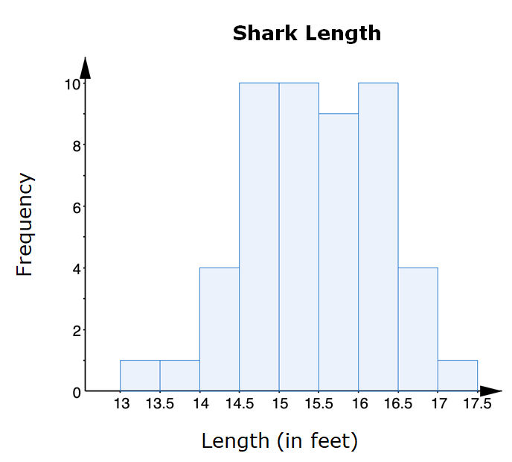
9.6.2 Guided Instruction: Shape of Distributions
Consider the histogram of the lengths of female sharks.
Sketch an approximate line of symmetry for the histogram.
If the histogram is folded along the line of symmetry, will each half line up perfectly?
Do you think all histograms will be symmetrical?
volume 2, pg. 70

Slide 9
The shape of the shark lengths histogram can be described as symmetric, but histograms can also have other shapes.
volume 2, pg. 70

Slide 10
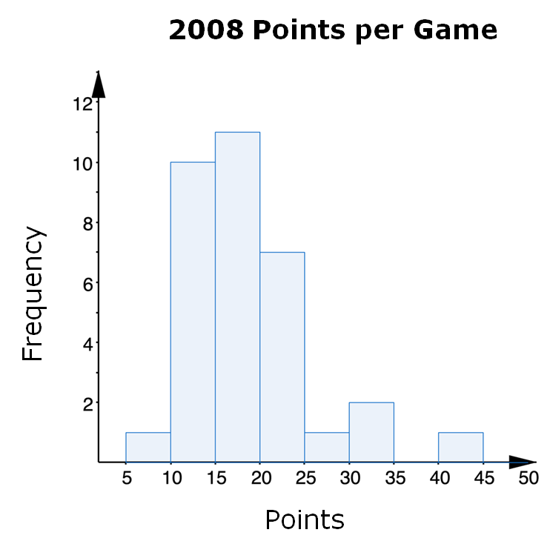
The histogram displays the number of points per game scored by a college basketball player during the 2008 season.
Discuss with your partner what you notice about the shape of the distribution of points scored per game.
A right-skewed graph has a longer trail of data to the right and the peak of the data on the left.
volume 2, pg. 71

Slide 11
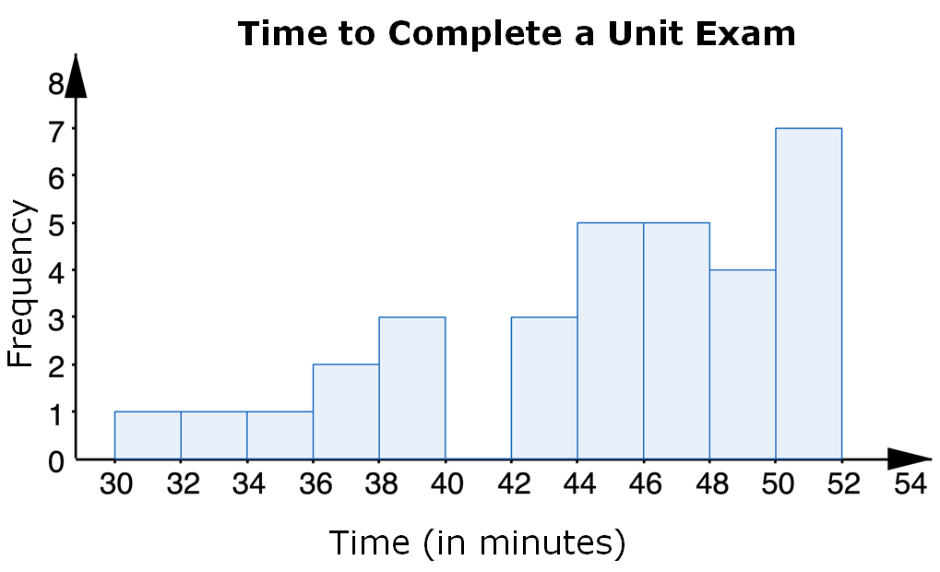
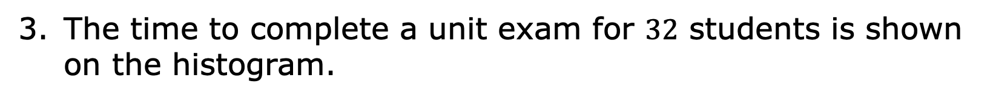
The time to complete a unit exam for $32$ students is shown on the histogram.
volume 2, pg. 71

Slide 12
Write an observation about the shape of the distribution of time spent to complete the exam.
A left-skewed graph has a longer trail of data to the left and the peak of the data on the right.
volume 2, pg. 71

Slide 13

Guided Practice
volume 2, pg. 72

Slide 14

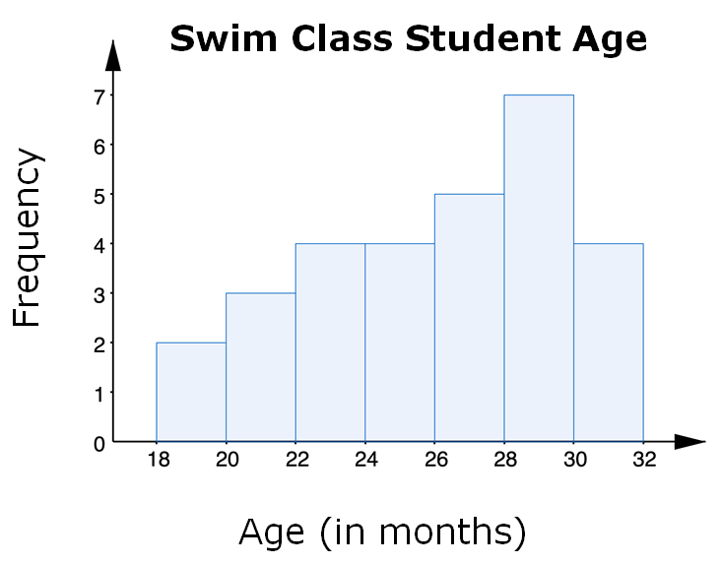
9.6.3 Guided Practice: Describing Shape of Distributions
This histogram shows the ages of students in a swimming class.
The shape of the distribution of ages can be best
described as
symmetric.
right skewed.
left skewed.
volume 2, pg. 72

Slide 15
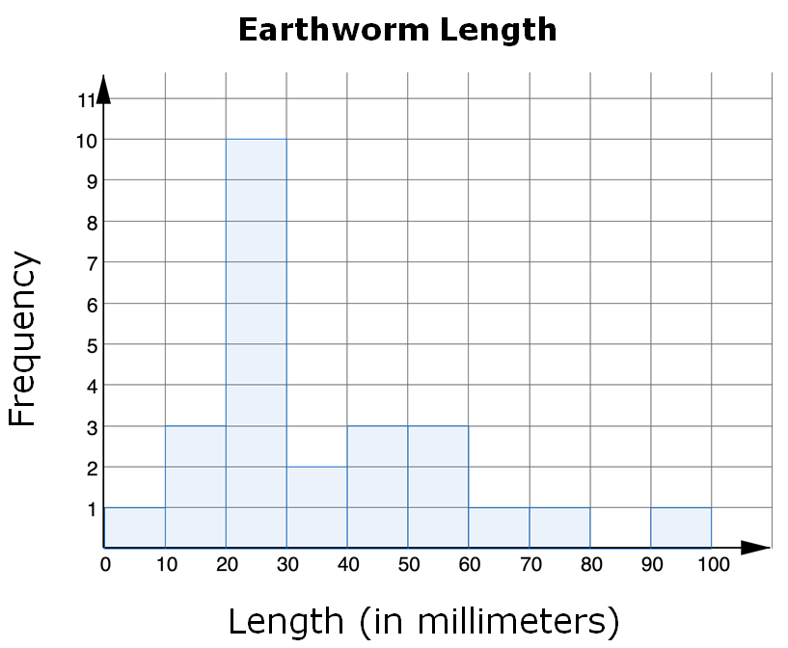

The histogram shows the length, in millimeters, of $25$ earthworms.
The shape of the distribution of the earthworms’ lengths
can be best described as
symmetric.
right skewed.
left skewed.
volume 2, pg. 72

Slide 16
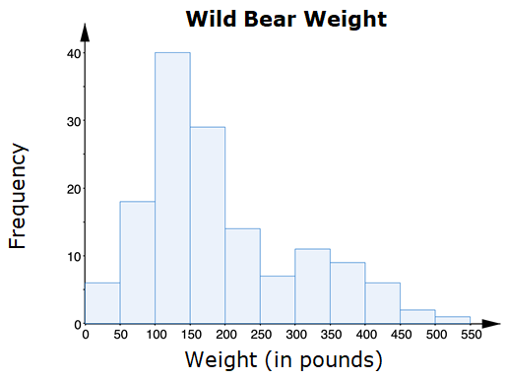

In one study of wild bears, researchers measured the weights, in pounds, of $143$ wild bears that ranged in age from newborn to $15$ years old. The data were used to make this histogram.
Describe the shape of the graph given the context.
volume 2, pg. 73

Slide 17
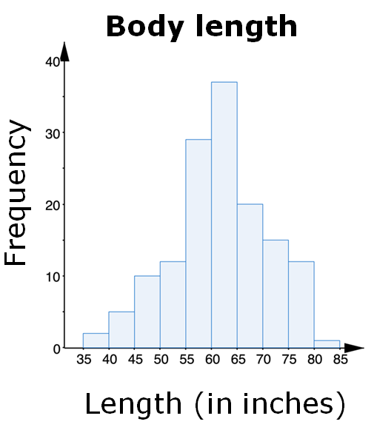
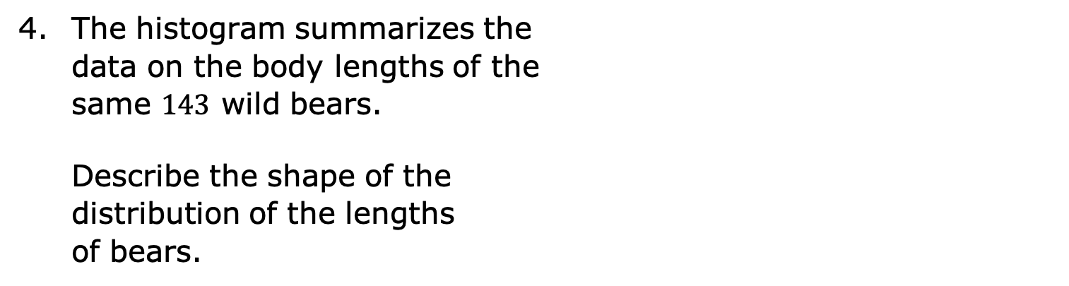
The histogram summarizes the data on the body lengths of the same $143$ wild bears.
Describe the shape of the distribution of the lengths of bears.
volume 2, pg. 73

Slide 18
Guided Instruction
volume 2, pg. 74

Slide 19
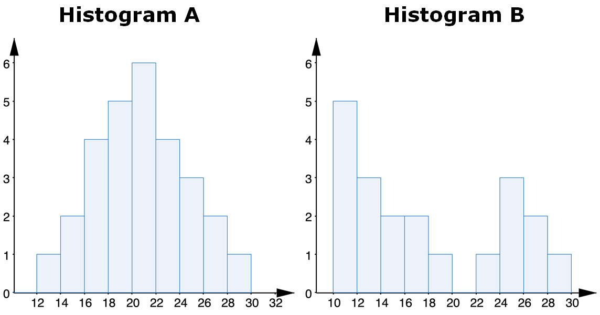
9.6.4 Guided Instruction: Features of Histograms
Below are two histograms with different shapes and features.
volume 2, pg. 74

Slide 20

Histogram A is and has a peak near _____.
Histogram B is and has
has two clusters.
symmetrical
not symmetrical
symmetrical
not symmetrical
one peak.
more than one peak.
A cluster is formed when data points are in a close group or numerical data have similar values on a number line.
Histogram A
Histogram B
volume 2, pg. 74

Slide 21

has a gap between ____ and ____.
If the data value were added to Histogram A, it would be considered an outlier.
A gap shows a location with no data values. On a histogram, a space between the bins indicates a gap, or a frequency of zero for that bin.
Histogram A
Histogram B
An outlier is a value that is much higher or much lower than the other values in a data set.
$12$
$24$
$40$
volume 2, pg. 74

Slide 22

Collaboration
volume 2, pg. 75

Slide 23

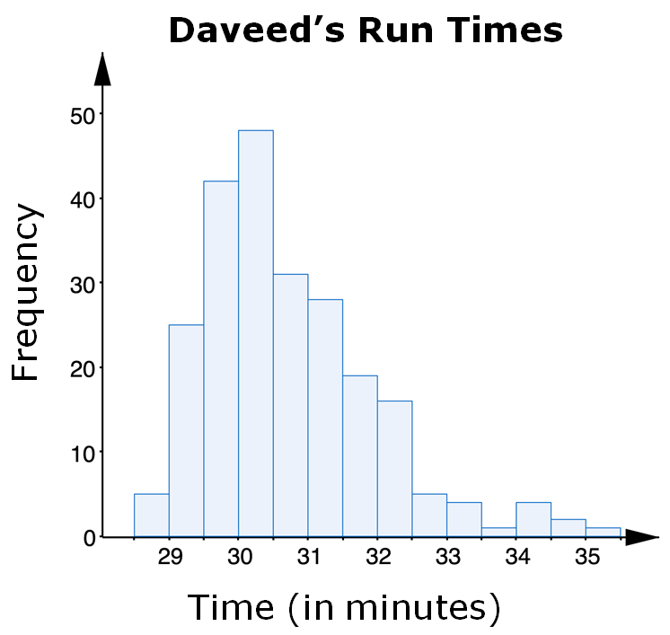
9.6.5 Collaboration: Features of Histograms
Daveed has been tracking the time, in minutes, it takes him to run 4 miles for the last 10 years. A histogram of Daveed’s run times is shown.
volume 2, pg. 75

Slide 24

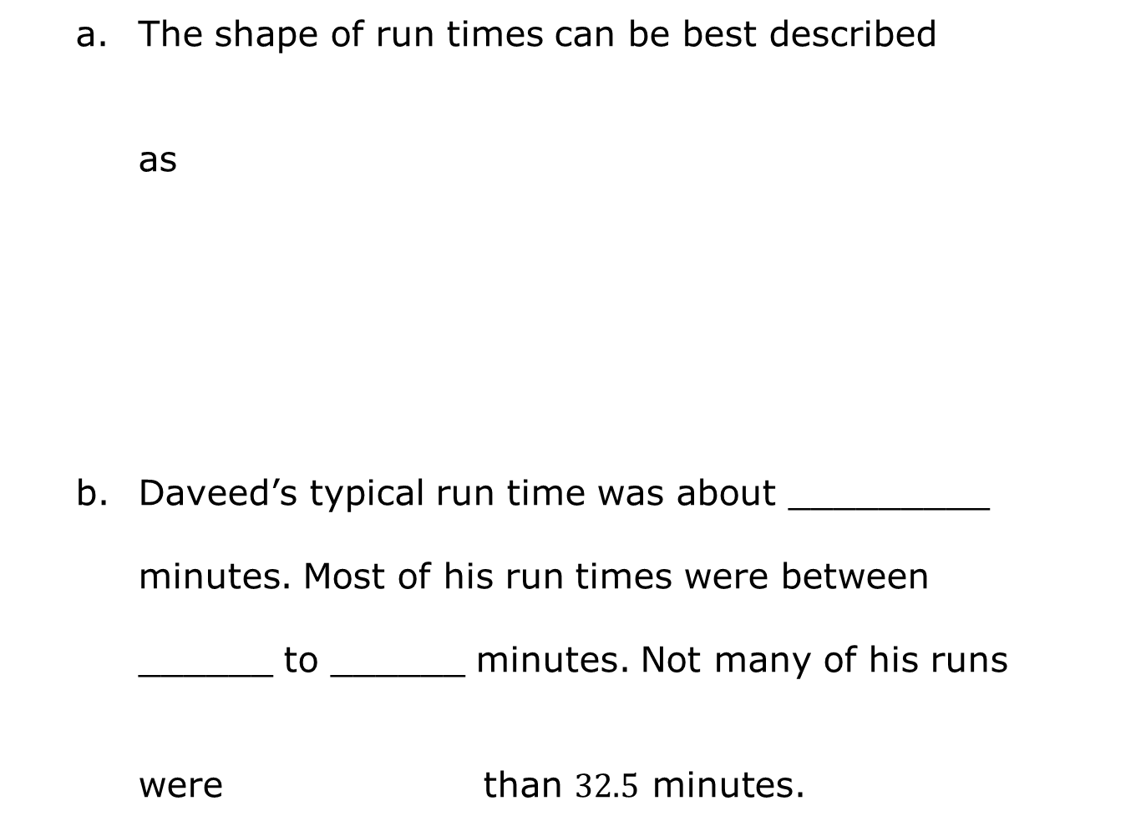
The shape of run times can be best described as
Daveed’s typical run time was about _________ minutes. Most of his run times were between ______ to ______ minutes. Not many of his runs were than $32.5$ minutes.
symmetrical.
right skewed.
left skewed.
shorter
longer
volume 2, pg. 75

Slide 25

Arya used the data of her $4$-mile run times to create a different histogram.
Discuss with your partner what you notice about the interval widths. Determine if there are any unusual features including clusters, gaps, or outliers. Write a detailed description of your discussion.
Arya’s Run Times
Frequency
Time (in minutes)
volume 2, pg. 75

Slide 26
At what interval in the histogram of Arya’s times is there an outlier?
Would this same data value also be considered an outlier in the histogram of Daveed’s times?
volume 2, pg. 76

Slide 27
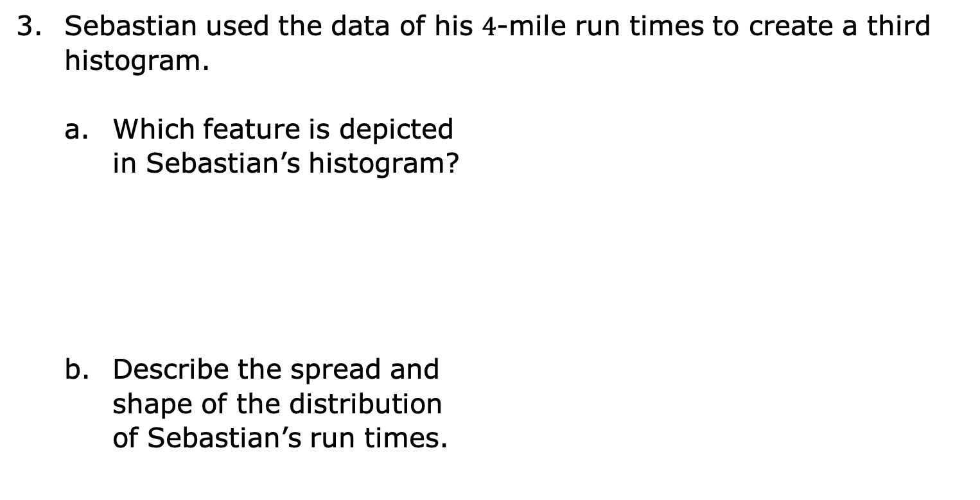
Sebastian used the data of his $4$-mile run times to create a third histogram.
Which feature is depicted in Sebastian’s histogram?
Describe the spread and shape of the distribution of Sebastian’s run times.
Sebastian’s Run Times
Frequency
Time (in minutes)
volume 2, pg. 76

Slide 28
Different data will change the intervals for the horizontal axis and will affect the histogram and its features: symmetry, skewness, gaps, clusters, outliers, and the range. With your partner, review all three run-time scenarios and discuss the differences between the histograms.
volume 2, pg. 76

Slide 29

Your Turn
volume 2, pg. 77

Slide 30
9.6.6 Your Turn!
The histograms show the number of text messages sent in one week by a group of $100$ sixth-grade and $100$ seventh-grade students.
Sixth Graders
Seventh Graders
Frequency
Frequency
Number of Text Messages
Number of Text Messages
volume 2, pg. 77

Slide 31
Describe the shape of the histogram for the number of text messages sent in one week by sixth-grade students.
Which group of students has the larger spread?
Explain if sixth graders or seventh graders tend to be more alike in terms of the number of text messages they send.
volume 2, pg. 77

Slide 32

Wrap-Up
volume 2, pg. 77

Slide 33
9.6.7 Wrap-Up: Reflection
Place an X on the line to indicate your understanding of parts of analyzing a histogram. Then provide a brief explanation or evidence to support your self-assessment.
I can describe the shape of a histogram.
I can describe gaps, outliers, and clusters in a histogram.
I need help. I can’t get started. | I’m getting there. | I understand and have evidence.
I need help. I can’t get started. | I’m getting there. | I understand and have evidence.
volume 2, pg. 77

Slide 34
I can describe the spread of a data set given a histogram.
I need help. I can’t get started. | I’m getting there. | I understand and have evidence.
volume 2, pg. 77

